Slide 1
PSHE and Citizenship
Health and Wellbeing | Think Positive
PSHE and Citizenship | UKS2 | Health and Wellbeing | Think Positive | Choices and Consequences | Lesson 4

Slide 3
Aim
I understand the importance of making good choices.
Success Criteria
I can identify when a choice or decision needs to be made.
I can consider the consequences of different choices.
I understand what it means to make an ‘informed decision’.
This resource is fully in line with the Learning Outcomes and Core Themes outlined in the PSHE Association’s Programme of Study.

Slide 4

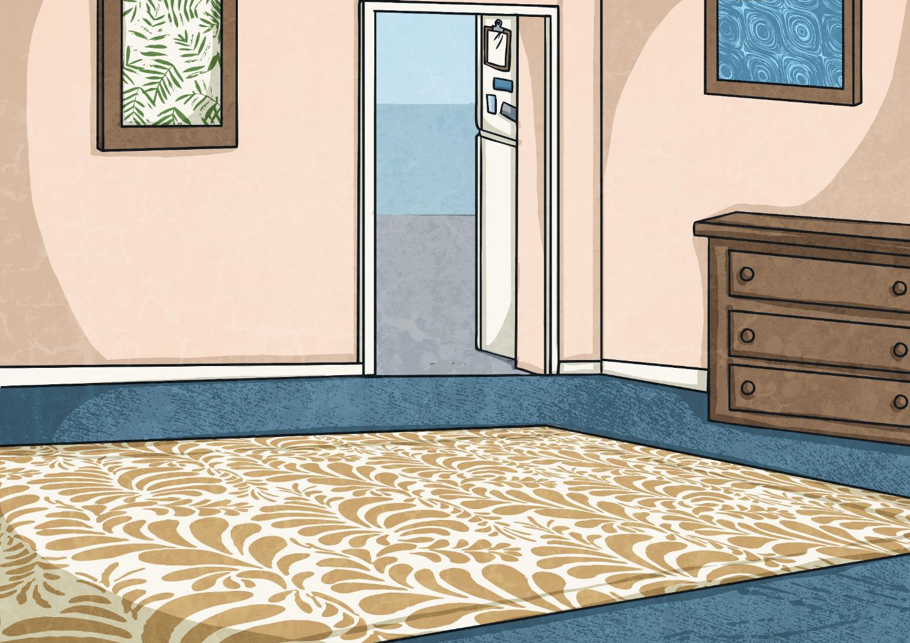



What sorts of decisions and choices do we have to make in life?
How can making good choices make us happy?

Slide 5


Daily Decisions
You might not have stopped to think about it but we make hundreds of decisions each and every day. Have a think now about the little decisions you have to make on a regular basis and jot them down on your paper.
You have two minutes to think of as many as you can!

Slide 6

Daily Decisions
Let’s share some of the things that you all put down.
We are faced with so many seemingly insignificant choices every day, such as what to have for breakfast, who to play with at playtime and what to watch on TV after school. Often, we don’t even realise that we have made decisions about things because we didn’t have to give them much thought and they certainly didn’t trouble us in any way.
But what about those trickier choices we have to make?

Slide 7

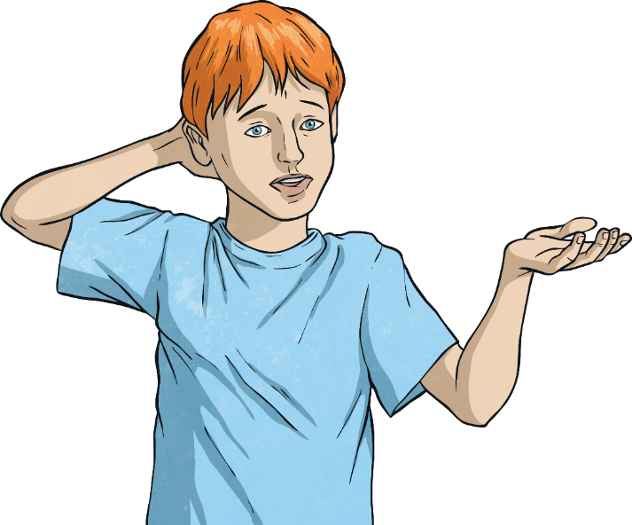
Difficult Decisions
Some choices we face can be pretty challenging, causing us to worry about making the right decision.
Talk to your partner about difficult decisions you have had to make or decisions you can imagine would be difficult for a person to make.
Remember, we are all different and what might seem like an easy decision for one person to make, could be a difficult decision for another person.

Slide 8

Difficult Decisions
Part of growing up is learning to make good choices and make your own decisions about things.
Let’s take a look at the type of decisions that you might have to face in the near future.

Slide 9
Difficult Decisions
You are trying to save up for some new trainers but you have been invited to the cinema with your friends. Should you spend your money or continue to save it?
You have taken a really funny video of one of your friends falling over. Should you share it on a social media site for all your other friends to see?
Your friend has asked if they can borrow your tablet over the weekend. Should you let them use it or not?
It’s Friday and you have been set homework to hand in on Monday. You would like to chill out tonight but you have a busy weekend planned. When should you do your homework?
You have visited a few secondary schools and need to decide which one to go to. Two of them are close by. One seems to do all your favourite subjects but the other is the one your best friend is going to go to.

Slide 10

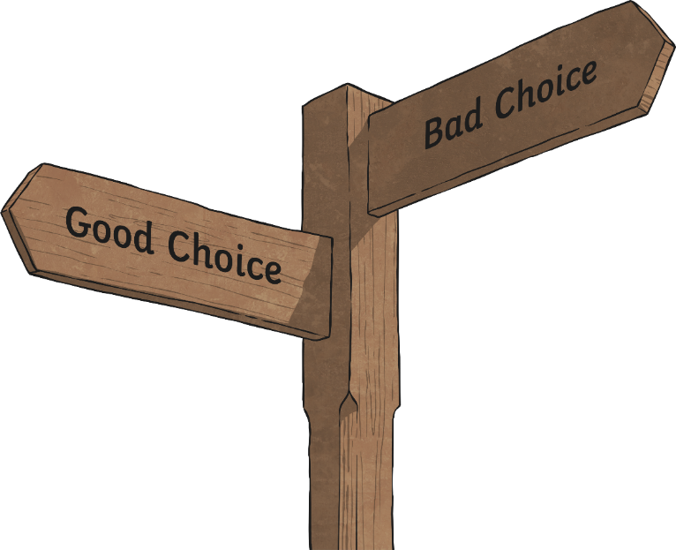
Making an Informed Choice
As you grow up and become more independent, you will have more important decisions to make.
Sometimes, the idea of making the ‘right’ decision can feel rather overwhelming so getting help from others and getting all the information about the different choices can really help.
Having more information means you can make what is called an informed choice.

Slide 11
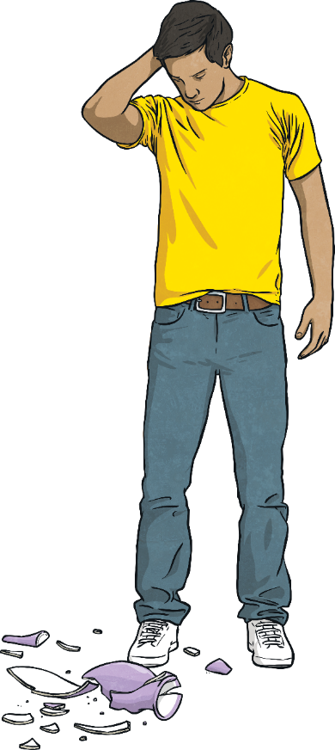
Making an Informed Choice
Every day, we have choices to make about what we do, what we say and how we respond to different situations.
One of the things we need to give a lot of thought to is the consequences of each choice we have.
Consequences are what will happen as a result of our decision. What we do or say, or how we react to a situation, will impact on us and others. We need to consider this impact in order to decide on the best choice to make.

Slide 12

Making an Informed Choice
Making an informed choice can often mean thinking about the following:
Are there laws or rules I need to consider?
What is the right thing to do morally?
Could anyone be hurt or upset by this decision?
Am I making a safe choice?
Might I regret this decision? Why?
What would… do? (Think of someone you look up to and respect and consider what decision they would make in this situation).

Slide 13


What Choices Do They Have?
Meet Beth. She is in Year 6 and has recently moved to a new house in a new area. She has also joined a new school and is finding it hard to make new friends.
One child in the class invites her to come along to karate after school with him. Beth has never tried karate – in fact, she isn’t very keen on any sport.
What choices does Beth have in this situation?
How could she get more information to help her decide what to do?
What might the consequences of her decisions be?

Slide 14
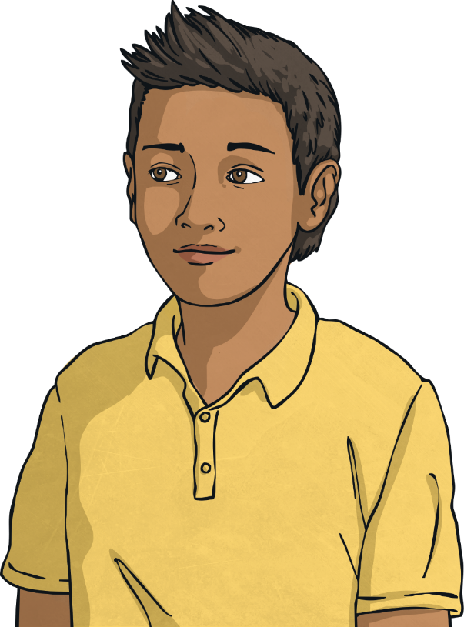
What Choices Do They Have?
Meet Husham. He is getting picked on by a group of boys in the other Year 6 class. They tease him, call him names, steal his bag and run off with it and sometimes push and shove him.
What choices does Husham have in this situation?
How could he get more information to help him decide what to do?
What might the consequences of his decisions be?

Slide 15
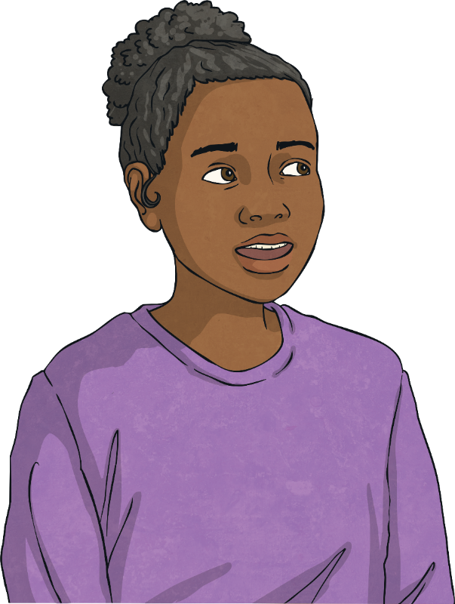
What Choices Do They Have?
Meet Fran. At the local supermarket, Fran’s friend has just put some batteries in her pocket, for her X-Box controller, without paying for them.
What choices does Fran have in this situation?
How could she get more information to help her decide what to do?
What might the consequences of her decisions be?

Slide 16
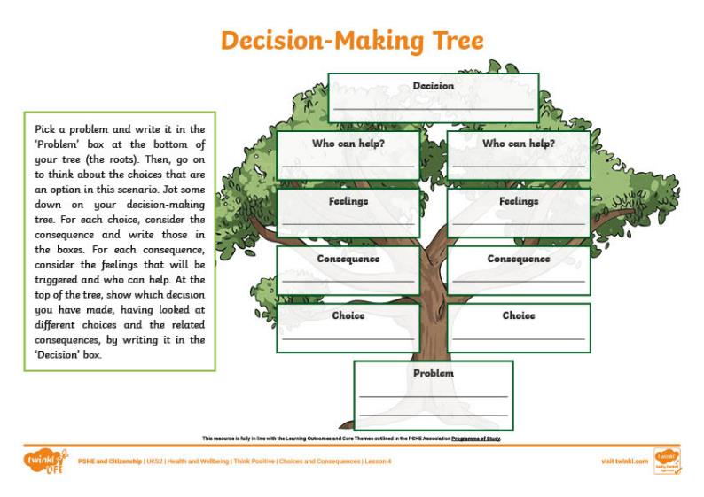
Decision-Making Trees
Let’s think back to the children we met earlier and the situations they were in. Each of them had different choices they could make about their situations.
Use one of the examples to fill in the information on your Decision-Making Tree Activity Sheet.
You will need to consider the choices and the
possible consequences of each choice.

Slide 17
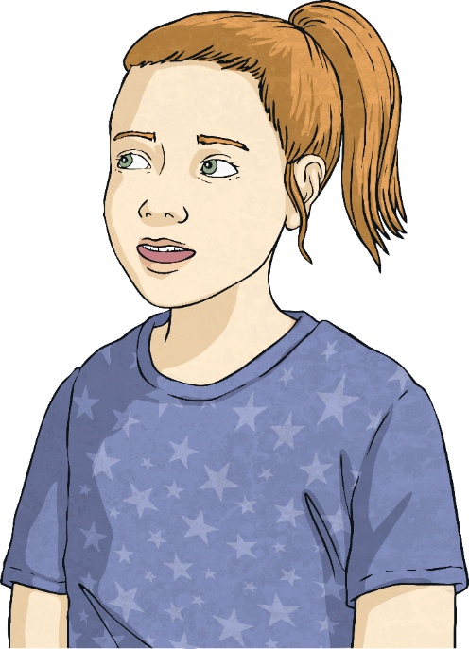
A Happy Outcome
Ultimately, when we make a decision about our actions or behaviours, we want a happy outcome.
Considering the impact of our decisions on ourselves and others can help us make good choices – choices that will lead to a positive outcome.
It is also important to remember, however, that making a not-so-good choice is OK, too. It’s how we learn. Seeing the impact of our decisions, whether good or bad, can help us make a good decision the next time we find ourselves in a similar situation.

Slide 18
A Happy Outcome
So, to get the best results when it comes to making good choices:
Consider all the choices you have in the situation.
Ask yourself if you have had to make this sort of decision before.
Think through each option you have and what the likely consequences (impact) would be on you and other people.
Ask for help or advice with important or difficult decisions; others might have experience of the situation or might have suggestions you had not thought of.
Try not to regret decisions you make, even if they don’t have a positive outcome; learn from your mistake and use it to improve your decision-making skills in the future!

Slide 19
What sorts of decisions and choices do we have to make in life?
How can making good choices make us happy?

Slide 20
Aim
I understand the importance of making good choices.
Success Criteria
I can identify when a choice or decision needs to be made.
I can consider the consequences of different choices.
I understand what it means to make an ‘informed decision’.
This resource is fully in line with the Learning Outcomes and Core Themes outlined in the PSHE Association’s Programme of Study.

