Slide 1
PSHE and Citizenship
Health and Wellbeing | Think Positive
PSHE and Citizenship | UKS2 | Health & Wellbeing | Think Positive | Face Your Feelings | Lesson 3

Slide 3
Aim
I can recognise and manage uncomfortable feelings.
Success Criteria
I am able to describe and discuss a range of emotions.
I understand how our feelings can impact on our thoughts and actions.
I can suggest strategies to cope with uncomfortable emotions.
This resource is fully in line with the Learning Outcomes and Core Themes outlined in the PSHE Association’s Programme of Study.

Slide 4
The Big Questions

Slide 5

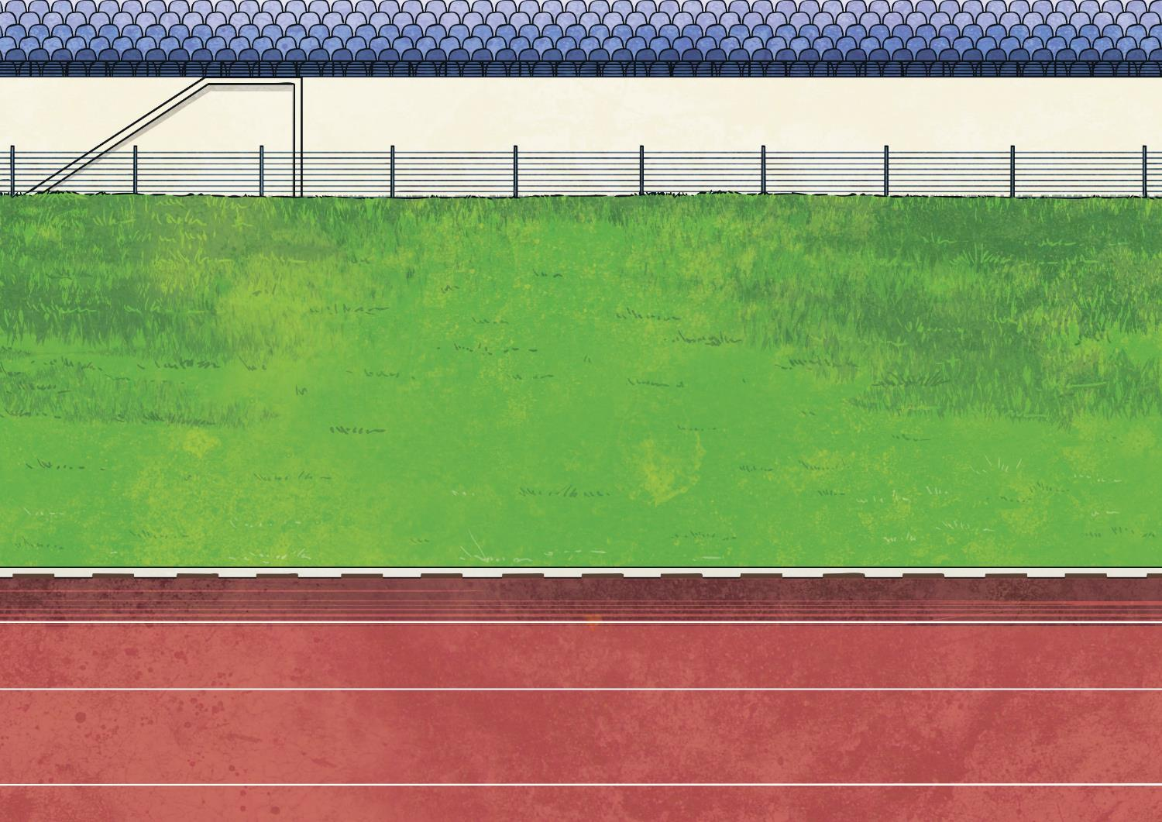

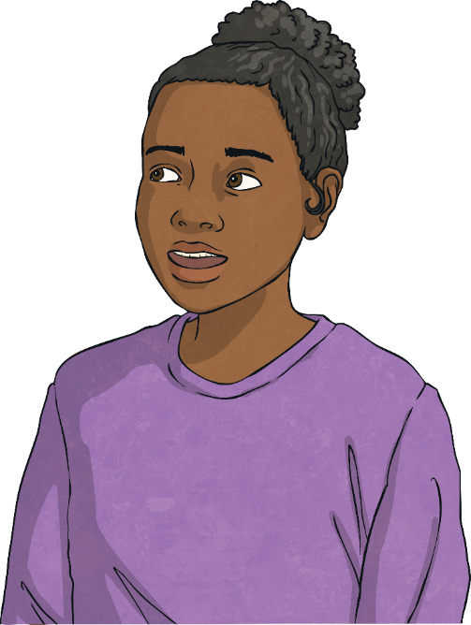
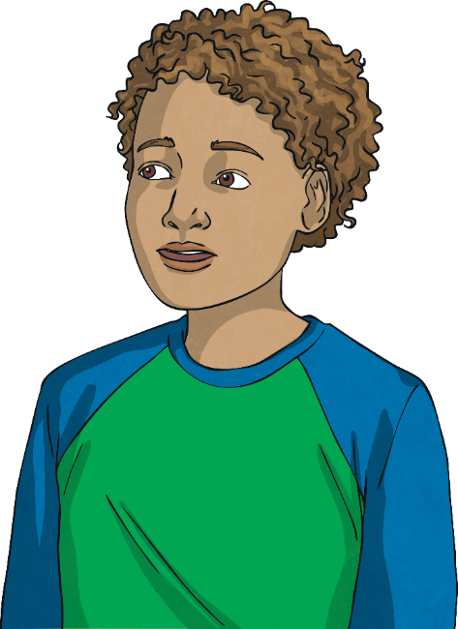
What can we
do to manage
uncomfortable feelings?
How do uncomfortable feelings affect our thoughts and actions?

Slide 6
Reconnecting

Slide 7


When Did You Last Feel…?
Let’s think about our emotions and try to recall a time when we recently felt the different feelings below. When each emotion pops up, jot down a time you can remember feeling like this and what caused that emotion.
nervous
angry
guilty
not good enough
upset
embarrassed
lonely
frustrated
anxious
jealous

Slide 8
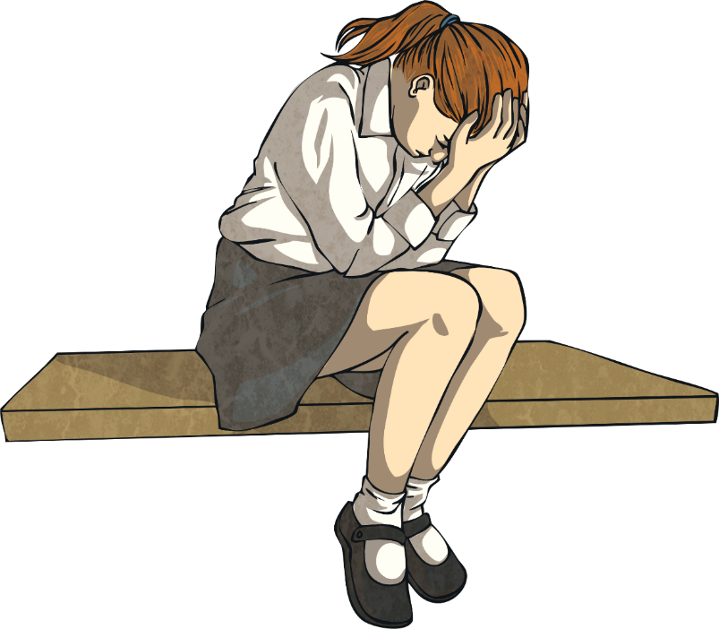
When Did You Last Feel…?
We all experience these uncomfortable emotions at some point in our lives and different things trigger these feelings in different people. What makes one person anxious might be no problem for someone else and something that angers one individual simply might not bother another.
It is important to remember that what others feel and experience is real to them, just as our emotions are real to us, and although the triggers may be different, the feelings can be very similar.

Slide 9
Exploring

Slide 10

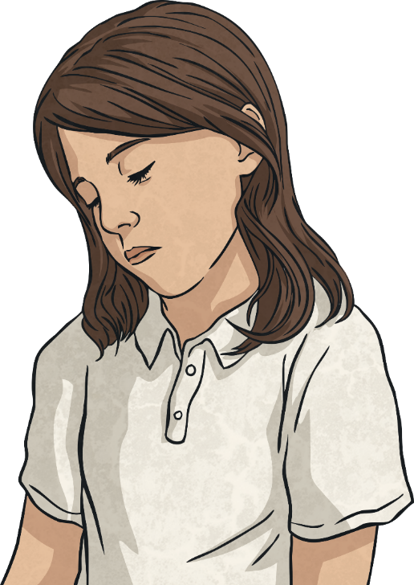
What Is Mental Wellbeing?
Mental wellbeing refers to our feelings and thoughts. Our feelings and thoughts are our mind's way of letting us figure out what is going on in our lives and how to react or respond.
Feeling uncomfortable emotions from time
to time is normal. However, if we are experiencing negative feelings often, or we are worried about our negative feelings, it can be a sign that we need help with our mental wellbeing.

Slide 11
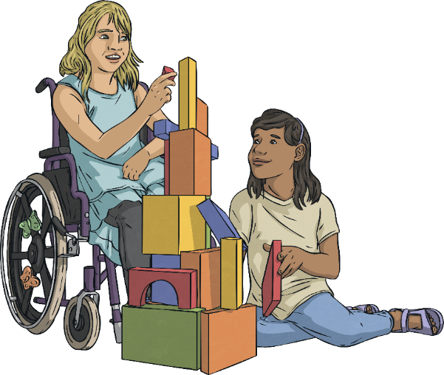
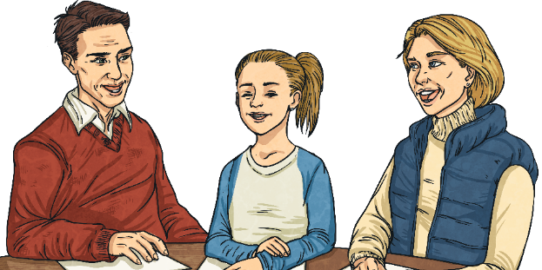
What Is Mental Wellbeing?
Anyone can experience difficulties with mental health.
If we are feeling particularly low, anxious, lonely or isolated, it means we are experiencing poor mental wellbeing and we need to seek support.
Who could you turn to for support with your mental health and wellbeing?
If someone we know doesn’t
seem to be coping well or doesn't seem to be their normal self, we might need to seek support on their behalf.

Slide 12
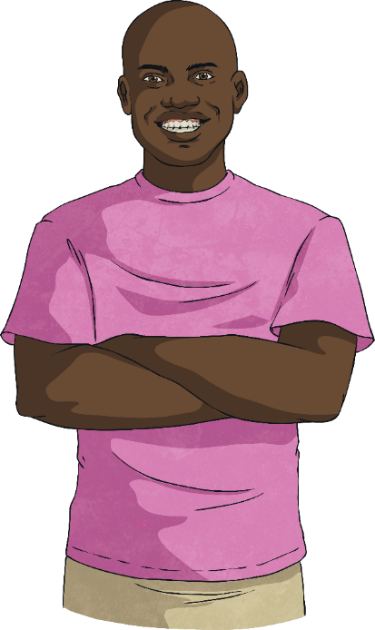
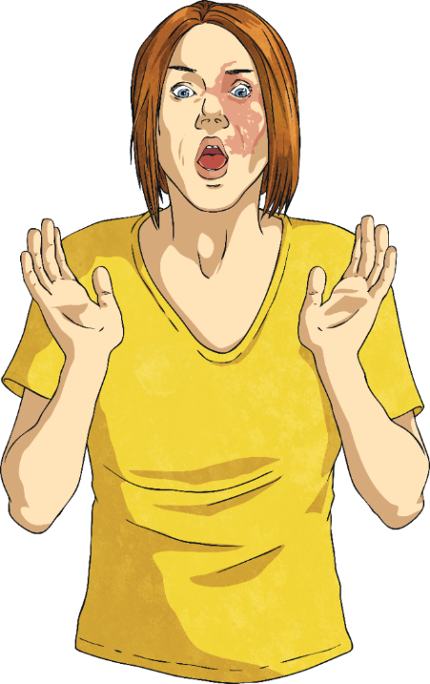
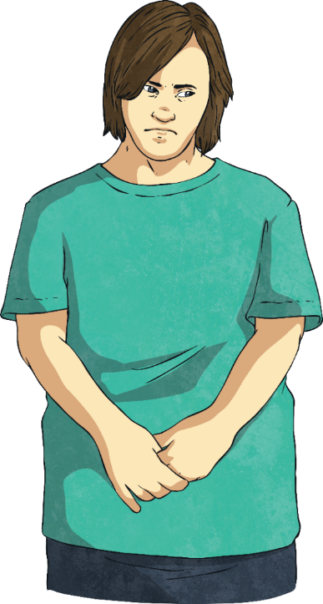
What Is Mental Wellbeing?
One thing we can all do to improve our mental wellbeing is to become familiar with different feelings and emotions and how to describe them. This can be useful when getting help to support positive mental health.

Slide 13
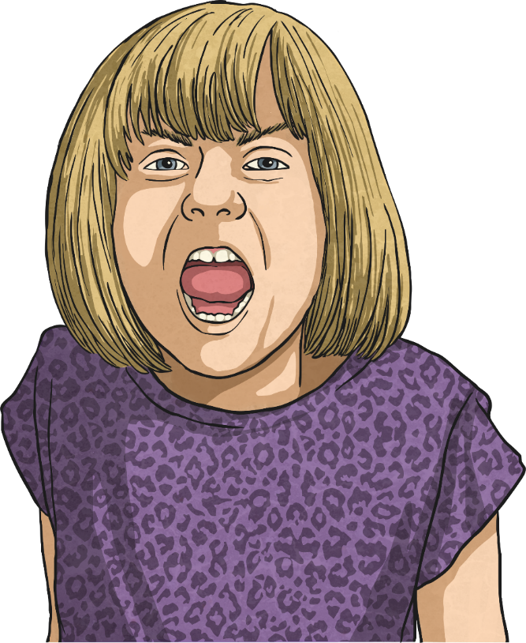
Recognising and Describing Our Feelings
Experiencing the feelings we have discussed can be very unpleasant and even a little frightening, especially if they are emotions we do not have much experience of.
However, we can become better at coping with these uncomfortable emotions if we try to better understand them.

Slide 14
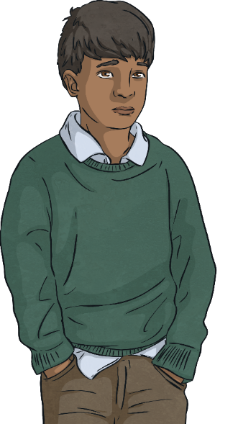
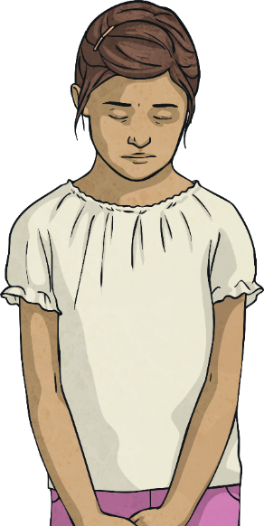
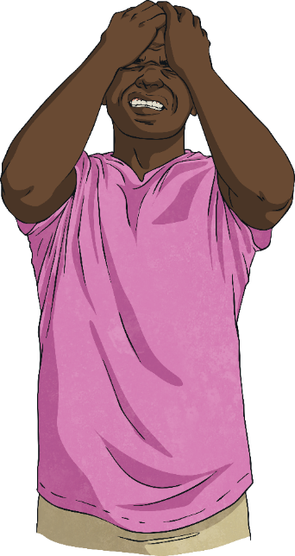
Recognising and Describing Our Feelings
Let’s explore some of those emotions mentioned earlier in more depth.
Talk to your partner and try to answer the following questions:
What does sadness feel like?
How do you feel inside when
you are nervous?
What kinds of thoughts go through your mind when you feel embarrassed?
Whereabouts in your body do you
feel anger?

Slide 15
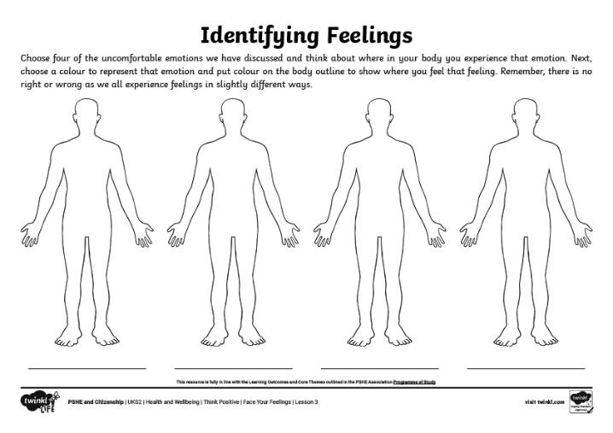
Understanding the Impact of Our Feelings
Sometimes, it can be useful to identify an emotion you are experiencing and label it in some way. Some people like to do this using colours.
Using the Identifying Feelings Activity Sheet, choose four different uncomfortable emotions and colour the areas of the body where you feel these feelings, using the colour you most associate with that emotion.
The colours we link to emotions, and where we feel these emotions in our bodies, might be different for everyone – there is no right or wrong here!

Slide 16
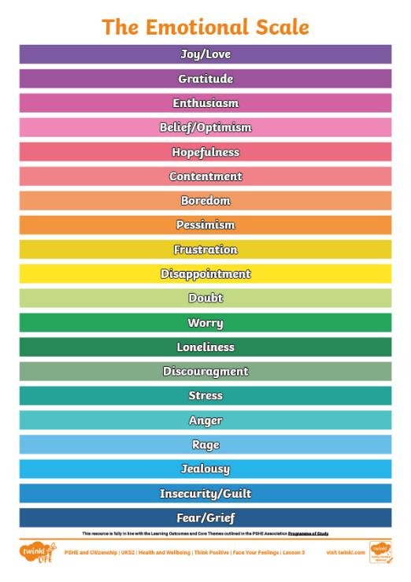
Understanding the Impact of Our Feelings
Another thing that can be useful to do, in terms of understanding our feelings, is to rate the emotion by asking ourselves how serious or intense the emotion is.
We can do this by using a scale like this…

Slide 17
Recognising and Describing Our Feelings
So, we are learning to pay attention to our feelings, recognise how they feel in our bodies and even place them on a scale.
Now, take a look at the following statement and take a few moments to think about it…
‘If feelings and emotions are inside us, they cannot have an impact on our actions, nor on anyone else.’
Do you agree or disagree with this statement?
Can you explain why you agree or disagree?

Slide 18
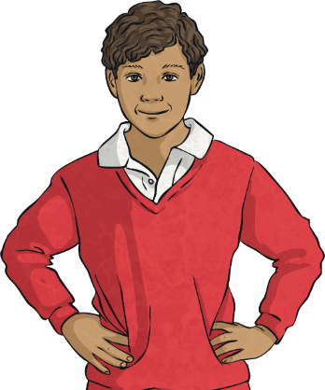
Understanding the Impact of Our Feelings
Some of you might have said that the way we feel can affect our thoughts and our actions. Our thoughts, feelings and actions are all linked to one another.
Thoughts
Consolidating
Reflecting
Feelings
Behaviours

Slide 19
Consolidating

Slide 20

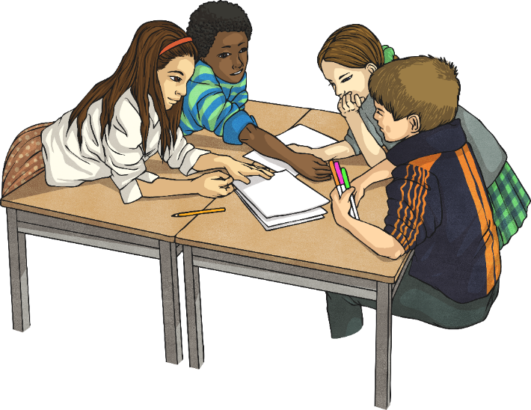
The Emotional Scale
You are now going to try an activity in your groups. Use the Emotions Scenario Cards to pick a scenario. Share it with the group, then discuss where you think that scenario should be on The Emotional Scale. Remember, there is no right or wrong and all individuals feel emotions differently. Try to come to an agreement as a group, listening to all members’ contributions.
Then, as a group, discuss what the child in the scenario might think and how they might act as a result of experiencing that emotion. Complete the Emotions Chart Activity Sheet for the scenario.

Slide 21
Reflecting

Slide 22

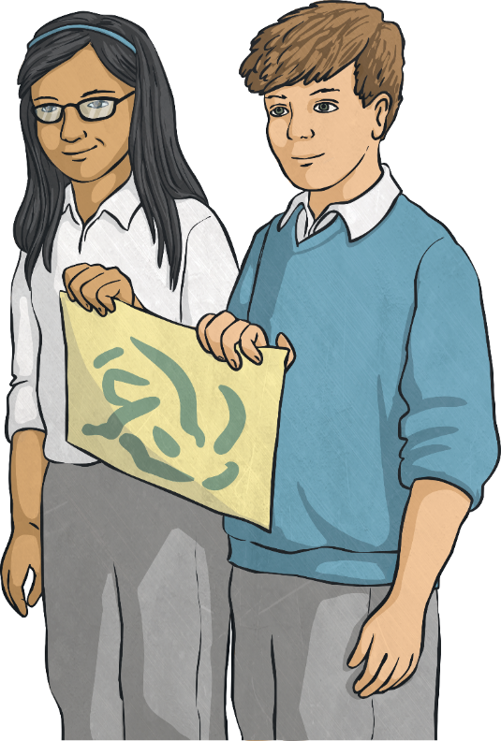
Managing Our Feelings
The more we experience different emotions, the more we learn how to deal with them.
Different people like to use different strategies to help manage their feelings.
Talk to your partner about any strategies you use, or have heard about, to help manage uncomfortable emotions.

Slide 23
Managing Our Feelings
Let’s share some of your ideas about how to deal with uncomfortable feelings.
Did you think of any of these?
Talk to someone about how you are feeling.
Count to ten and focus on your breathing.
Take some time out, away from the current situation.
Write your feelings down.
Listen to music or spend time with a pet.

Slide 24
The Big Questions

Slide 25
What can we
do to manage
uncomfortable feelings?
How do uncomfortable feelings affect our thoughts and actions?

Slide 26
Aim
I can recognise and manage uncomfortable feelings.
Success Criteria
I am able to describe and discuss a range of emotions.
I understand how our feelings can impact on our thoughts and actions.
I can suggest strategies to cope with uncomfortable emotions.
This resource is fully in line with the Learning Outcomes and Core Themes outlined in the PSHE Association’s Programme of Study.

