Slide 2
Aim
I understand the concept and impact of positive thinking.
Success Criteria
I can identify helpful and unhelpful thoughts.
I can name some strategies to deal with unhelpful thoughts.
I can generate positive affirmations.
This resource is fully in line with the Learning Outcomes and Core Themes outlined in the PSHE Association’s Programme of Study.

Slide 3





How do helpful and unhelpful thoughts
affect the way we feel and act?
What should we do when we have
unhelpful thoughts?
How can we encourage
helpful thoughts?

Slide 4


Penny for Your Thoughts
Have you ever heard the saying 'a penny for your thoughts'? It is said when one person is deep in thought and another person wants to know what they are thinking.
Our thoughts can be positive or negative and it is completely normal to have a mixture of both.
Sometimes we keep our thoughts to
ourselves, especially the negative ones,
but it can be good to share your thoughts
with someone else. That’s why this expression can be a good one to use – it helps people to share their thoughts, instead of bottling them up.

Slide 5


Penny for Your Thoughts
On your penny, write a negative thought that you have had recently or one you often have…
It might be one where you are thinking something negative about yourself.
It might be a thought linked to a particular worry or fear.
It might be a negative thought about something that is going to happen.
Let’s share some of the negative thoughts you wrote down to make sure we are all clear about what a negative, or unhelpful, thought is.

Slide 6

Unhelpful Thoughts
What is the impact of negative thoughts? After all, they are just thoughts!
With your partner, think of some consequences of negative thoughts…
Why might negative thoughts be called unhelpful thoughts?
How might they affect the way we feel?
How might they impact the way we act?
What might happen because of a negative thought?
Can negative thoughts affect those around us?

Slide 7
Unhelpful Thoughts
According to science, we tend to dwell on negative thoughts more than positive thoughts. This means they tend to stick around for longer in our minds. This is a real nuisance because those negative thoughts can cause us to produce stress chemicals in the brain which make us feel uncomfortable feelings.
When was the last time you felt any of these emotions?
self-doubt
panic
guilt
anger
worry
tearful
jealousy
stress
fear

Slide 8

Dealing With Unhelpful Thoughts
Unhelpful (or negative) thoughts are normal and are a part of life. It isn’t wrong to have them but we need to know what to do with them, especially if we seem to be having a lot of them!
There are different strategies that work for different people.

Slide 9
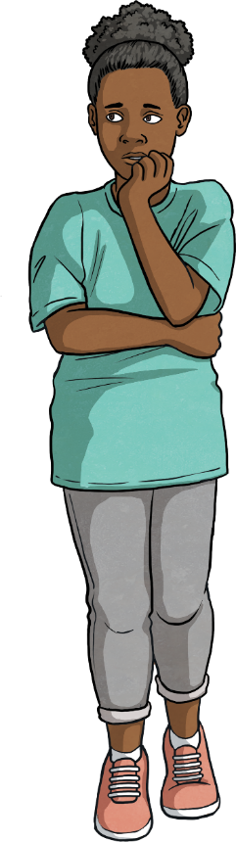
Dealing With Unhelpful Thoughts
Use worry dolls or a worry monster.
Share your thoughts with someone you love and trust.
Write your thoughts down in a thought journal.
Listen to the unhelpful thoughts and talk back to them.
Remind yourself that thoughts are not facts!
Next

Slide 10


Worry Dolls and Worry Monsters
Back
Dealing With Unhelpful Thoughts
Many people tell their unhelpful thoughts to worry dolls. These tiny dolls originated in Guatemala. They are usually kept in a small bag or box and a lot of people keep them under their pillow. If you share the negative thoughts with the dolls, then put them under your pillow before you go to sleep, it can leave your mind clear to get a good night’s sleep.
Worry monsters work in a very similar way. Many children use worry monsters to eat up their unhelpful thoughts! They are cuddly toys who eat the worries you have written down on pieces of paper. A lot of people also use these at night before going to sleep.

Slide 11
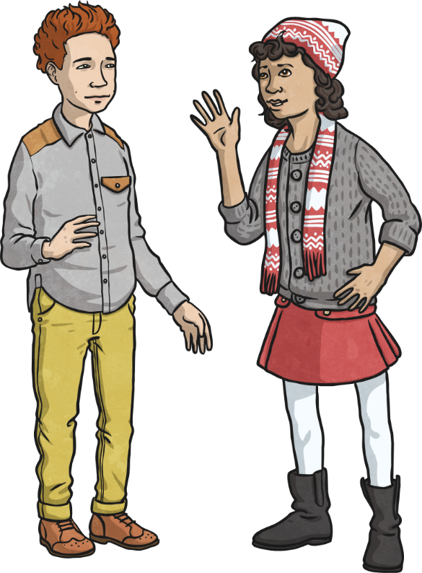
Dealing With Unhelpful Thoughts
Back
Sharing Thoughts with Others
Just as sharing your negative thoughts with worry dolls (or feeding them to a worry monster) can help get them off of your mind, telling them to someone else can also help.
Talking to a family member or a close friend about your worries or fears can often be a great way to deal with them. Other people may have some good advice or might be able to help you see that they are not as bad as you think they are.

Slide 12

Dealing With Unhelpful Thoughts
Back
Keeping a thought journal
Writing unhelpful thoughts down is a bit like sharing them with someone else. Although there is no one there to listen and give advice, it does help you to get them out of your head. When you read them back, they often don’t seem quite as bad and you can sometimes see a way to turn them into more helpful thoughts.

Slide 13

Dealing With Unhelpful Thoughts
Back
Talking Back to Unhelpful Thoughts
Even if you are on your own, with no worry dolls and nowhere to write your unhelpful thoughts down, you can learn to identify your negative thoughts and talk back to them.
You could maybe give your negative voice a name and imagine you are giving them the sort of advice you would give a friend if they shared these thoughts with you.
Remember, you don’t have to talk out loud – the thoughts are inside your head!

Slide 14
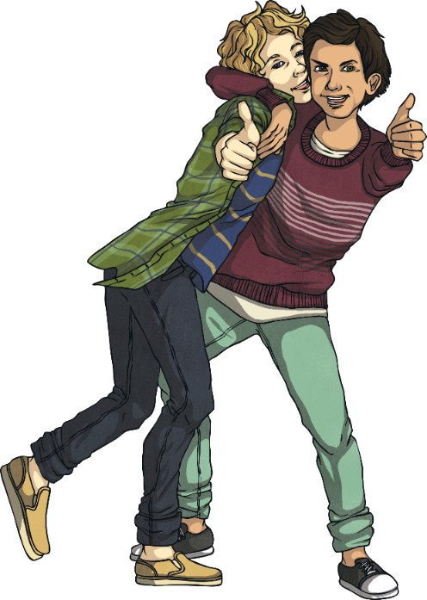
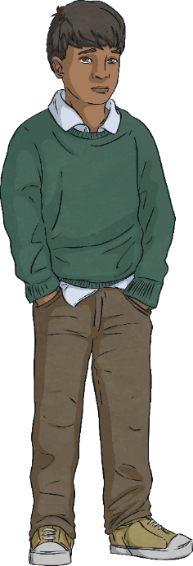
Back
Dealing With Unhelpful Thoughts
Thoughts Are Not Facts!
Negative thoughts can be very powerful and we tend to believe they are true, even if we have no real proof.
We might be thinking,
‘I am so stupid. I bet I am the only one who doesn’t understand this. I can’t ask the teacher because everyone will laugh at me.’
But that doesn’t make it true. Our thoughts come from within us and we all think differently. We all have different personalities and different opinions. Some people are more positive thinkers than others.
Remember, thoughts are not facts!

Slide 15
Developing a Positive Mental Attitude
So, how can we learn to be more positive and not have so many negative thoughts?
Like anything, if we can get into good habits and if we practise at it, we will get better at doing it.
We can use the techniques we have just learnt about when negative or unhelpful thoughts pop into our heads.
There are other things we can do too, to promote a healthy, positive mindset.
Can you think of anything that might help us have a more positive attitude?
Let’s take a look at some ideas…

Slide 16
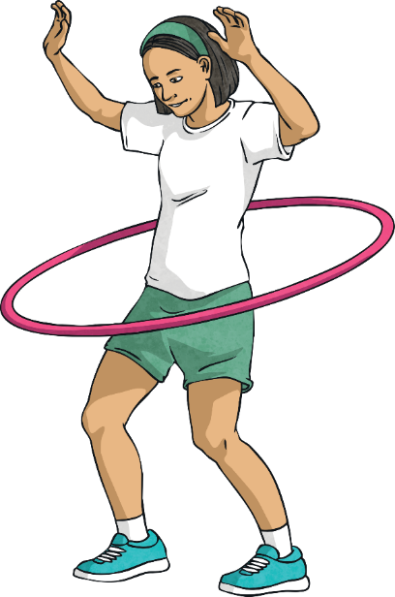
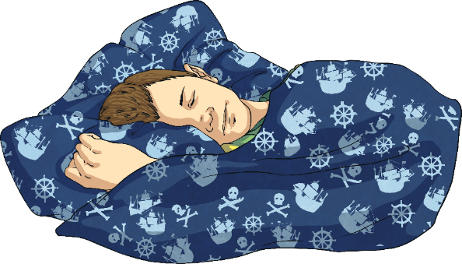


Developing a Positive Mental Attitude
Look After Your Body
Eat healthily – good food improves your mood!
Get plenty of exercise – exercise makes your brain release feel-good chemicals called endorphins.
Get enough sleep – it’s hard to stay positive when you’re tired and grouchy!
Drink enough water – when our body is dehydrated, it can affect our mood in a negative way.

Slide 17
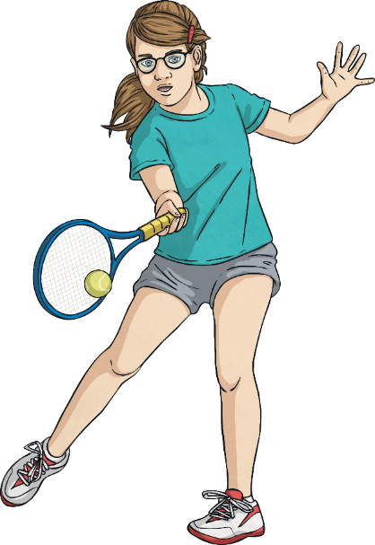
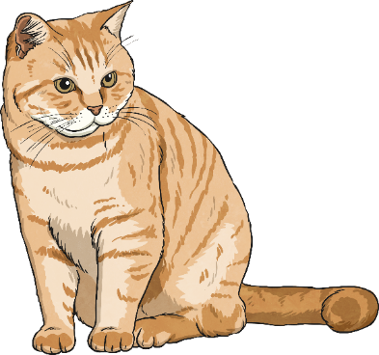

Developing a Positive Mental Attitude
Do the Things You Love
Doing the things you love doing can really help you to keep a positive mental attitude.
Maybe you have a favourite sport, a hobby or a pet to play with?
Maybe you love being with your friends or family?
Maybe you love to get stuck into a good book or watch a favourite film?

Slide 18

Developing a Positive Mental Attitude
Laugh Often
Laughing is really good for you!
Even just smiling can lift your mood!
So take the opportunity to share a joke, watch a funny video clip or tell a funny story.

Slide 19
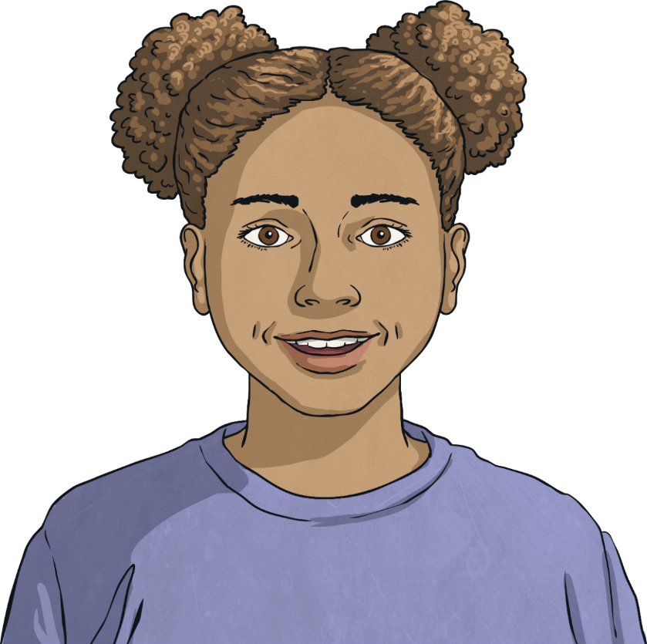
Developing a Positive Mental Attitude
Start the Day With a Positive Thought
Start as you mean to go on.
If you can start the day with a positive thought, the rest of the day may follow a positive path.
Think about something you are looking forward to each day and start the day with a smile!

Slide 20
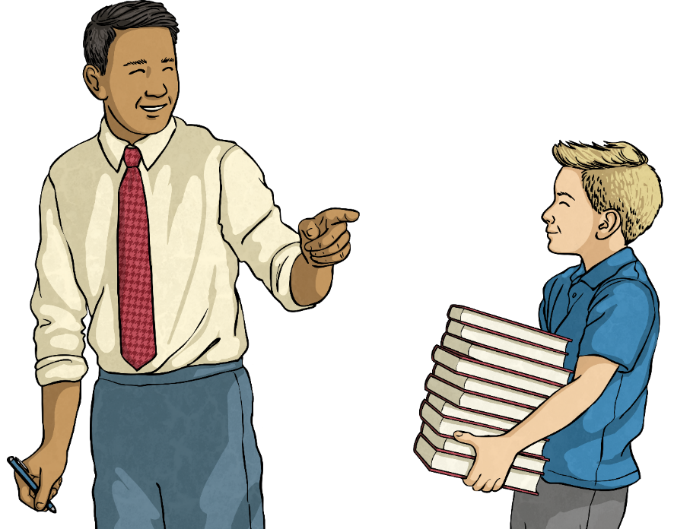
Developing a Positive Mental Attitude
Help Others
Doing things for others not only helps them but gives us a really good feeling.
Being a kind, caring and helpful person can really impact on your general outlook.
Give it a try and start today!

Slide 21
Consolidating
Reflecting

Slide 22

Positive Affirmations
A positive affirmation is a helpful thought that you can say in your head or out loud to get you feeling more positive.
The more we say these affirmations to ourselves, the more we believe them and the more positive we start to feel.
A lot of people use positive affirmations to help them develop a more positive mindset.

Slide 23
Positive Affirmations
Let’s look at some examples of positive affirmations (or helpful thoughts).
I am in charge of my life!
It’s OK to not know everything.
The best person I can be is me!
I can get through anything!
Today, I choose to be confident.
If I fall, I will get back up again.
I believe in myself.
I am going to try my best.

Slide 24
Thought or Fact?
Everyone will hate my new haircut!
I will never understand the rules of this game.
You can learn to think in a more positive way.
Exercise makes the brain release endorphins.
Laughing lifts your mood.
I will get better at this if I practise.
No one will like me if I say I enjoy puzzles and numbers.
You can talk back to negative thoughts with a positive voice.
I’ll always be rubbish at sport.

Slide 25
How do helpful and unhelpful thoughts
affect the way we feel and act?
What should we do when we have
unhelpful thoughts?
How can we encourage
helpful thoughts?

